Slide 1
Q.Cells – Energy Storage System
Q.Home Core
Q.OMMAND Remote Monitoring
Presented by Michael O‘Leary

Slide 2
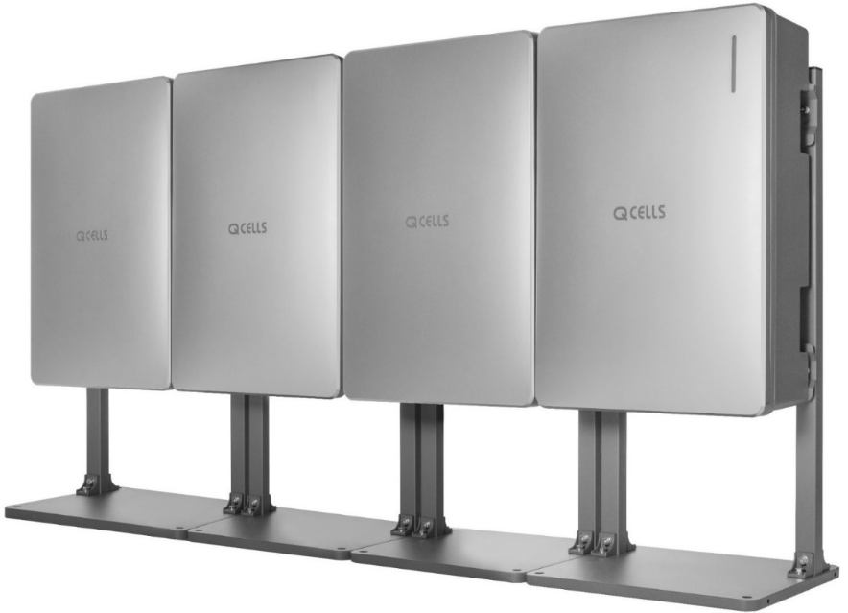
Q.HOME CORE

Slide 3
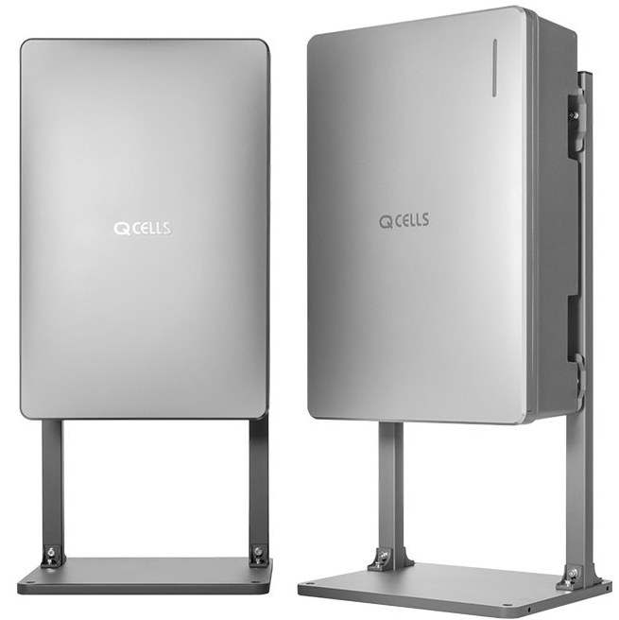
Q.HOME CORE
Q.SAVE
6,86 kWh / Battery Pack
Q.VOLT
5 kW
3.68 kW
Hybrid or AC Inverter
Single phase ESS as
Hybrid System Q.HOME CORE H4 with 2 MPPT
AC-coupled System Q.HOME CORE A4
Rechargeable NMC Battery by Samsung SDI
Extendable up to 3 batteries total (capacity 6,86kwh, 13.7kwh &
20.5kWh)
Self-learning EMS & weather forecast system
Easy set up: Wall or floor mounting

Slide 4
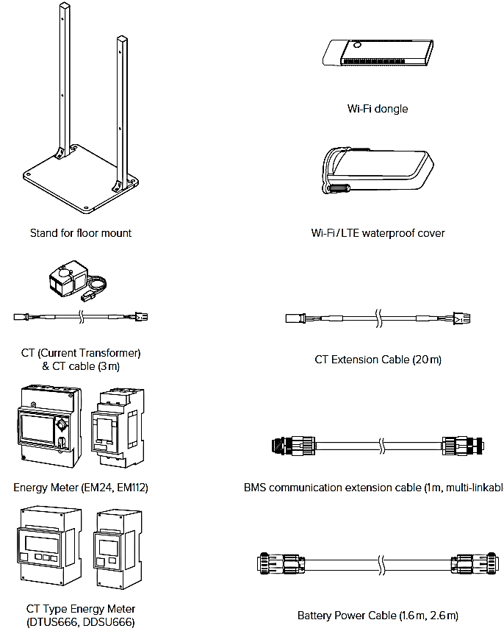
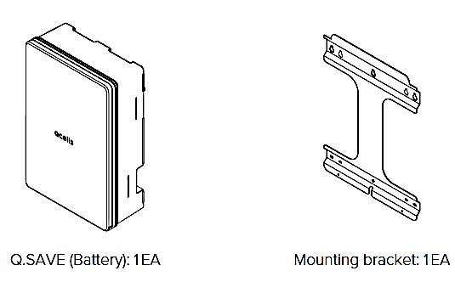
PACKAGE CONTENT
OPTIONAL
2x
Q.Volt Single Phase (Hyb or AC) & Q.SAVE Battery
Mounting Bracket & screws for both
Power and Communication cable (0.6m)
PV-connector (for Hybrid Inverter)
Optional: Dongle, Energy Meter, Stand for floor mount, extention cables

Slide 5
CORE H4 – Hybrid Inverter with 2 MPPTs
ITEM | Q.VOLT H4 Hybrid
Dimension | 460x700x238 mm
Weight | 37,5 kg
Protection Class | IP65
Mounting | Wall and Floor*
MPPT- Range/ Startup Voltage | 90 – 550V / 120V
Max. Installation Capacity | 8,0 kWp (4,0 per MPPT)
Max. Feed In | 5,0kW
Back-Up Power Battery | 3,3 to 4,5 kW – with 1 Battery 5kW – with 2 Batteries
Communications | LAN, RS485, CAN, Wi-Fi*, LTE*
*Optional parts separate to order

Slide 6
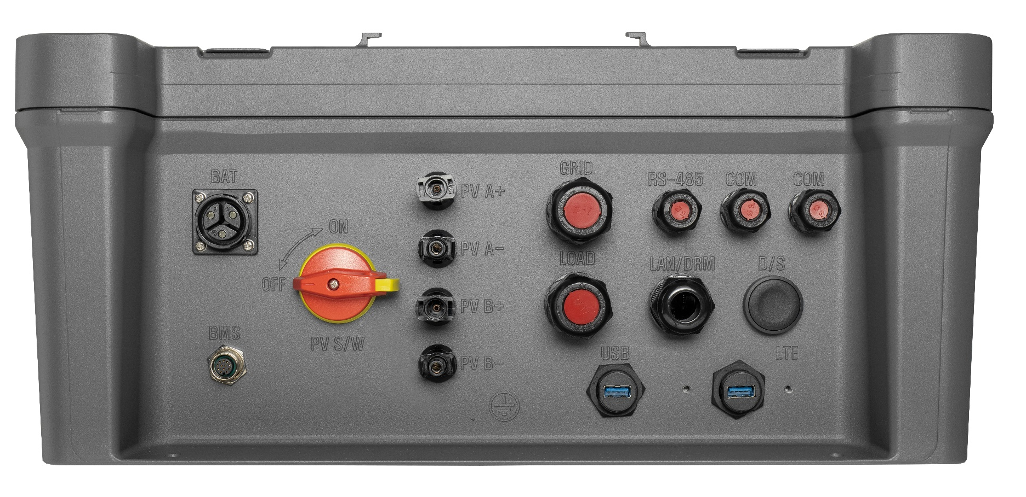
Q.Volt H4 HYB PCS bottom
Q.HOME CORE H4
Power connections
Battery connections
PV 1(A) and PV 2(B)
E-Meter and LAN
For future propose
Black Start switch for power up the system
Power switch
USB connector for set up
USB connector WIFI Dongle

Slide 7
Battery
Item | Q.SAVE B6.8S
Dimension | 460x700x238 mm
Weight | 61,1 kg
Protection class | IP65
Mounting | Wall and floor* mount possible
Battery energy | 6.8 kWh
Usable energy | 6,51 kWh
Depth of discharge (DoD) | 95%
Back-Up Power Battery | 3,3 to 4,5 kW @1 battery and 5kW with @2 batteries
Communications | CAN
*additional parts separate to order

Slide 8
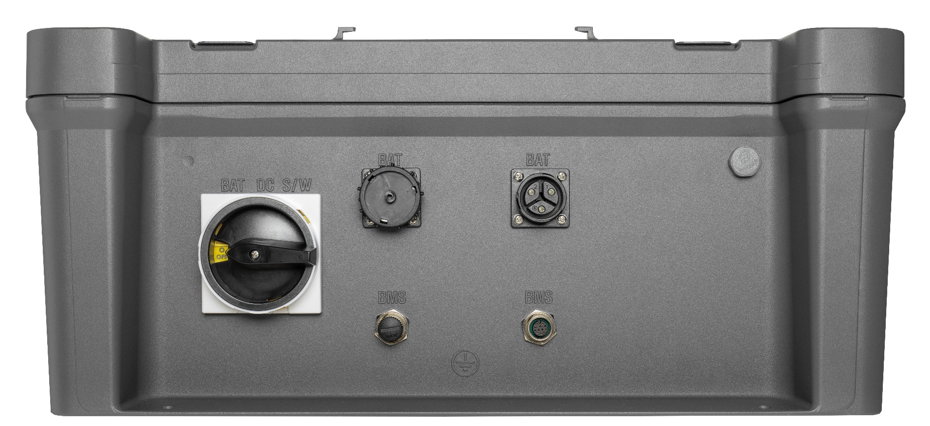
Q.Save Q.Home Core Battery
Q.HOME CORE Battery
Battery connection 2
Battery connection 1
Battery switch

Slide 9
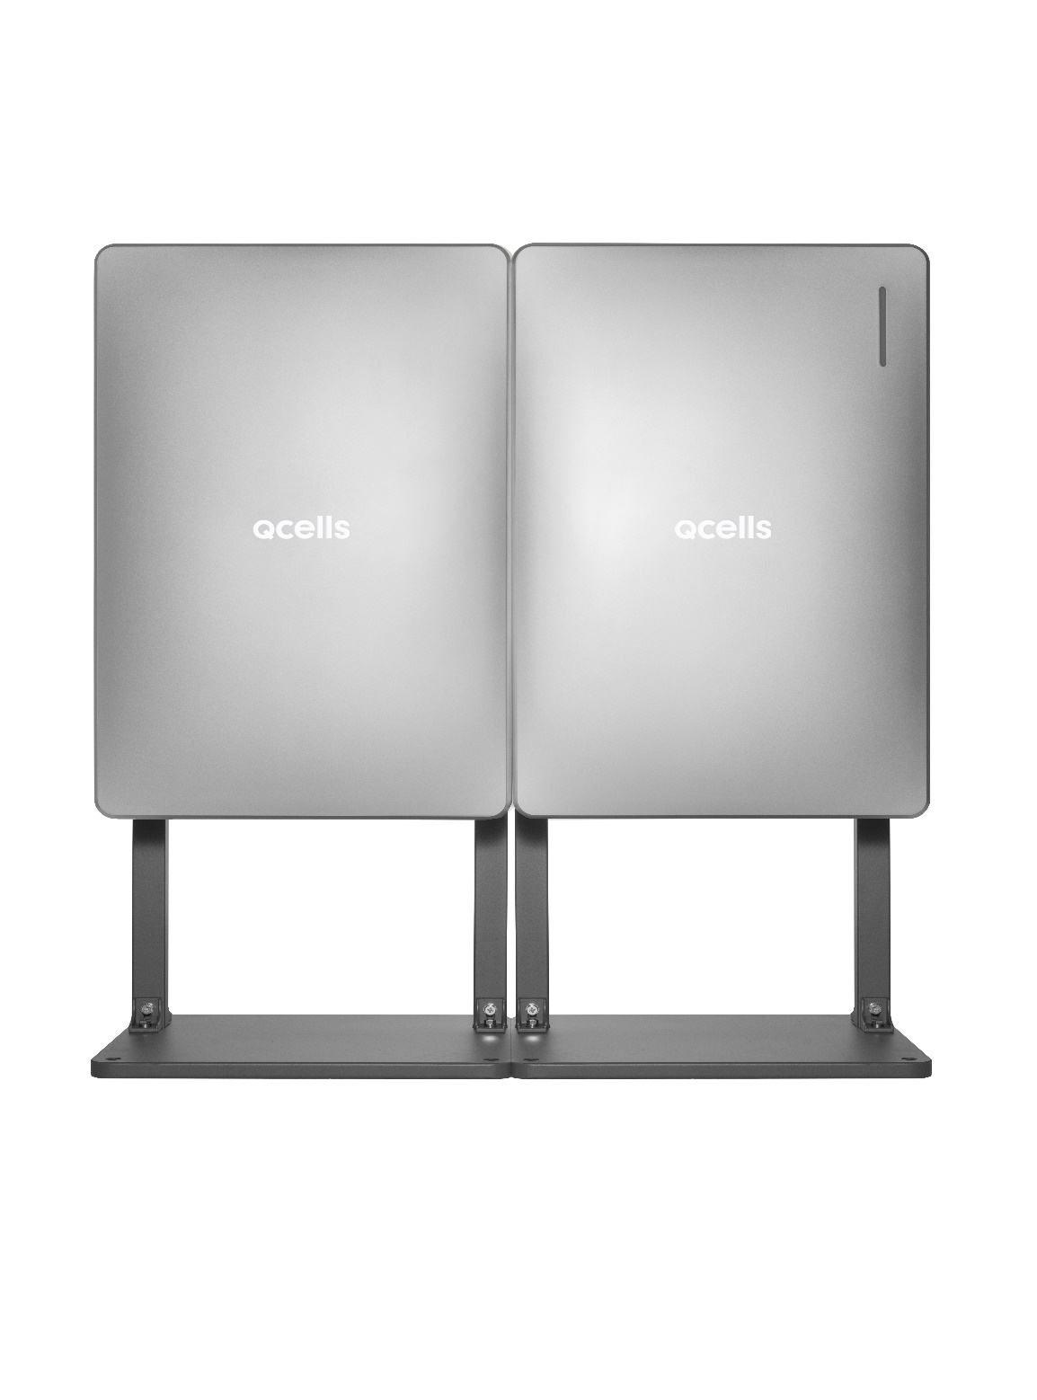
USP’s
.15 Year warranty on the Battery & Inverter
. UK support – Technical – presales & Aftersales
. Engineered in Germany & Manufactured in South Korea by Samsung
. NCA Battery Cells manufactured by Samsung to ensure maximum safety.

Slide 10
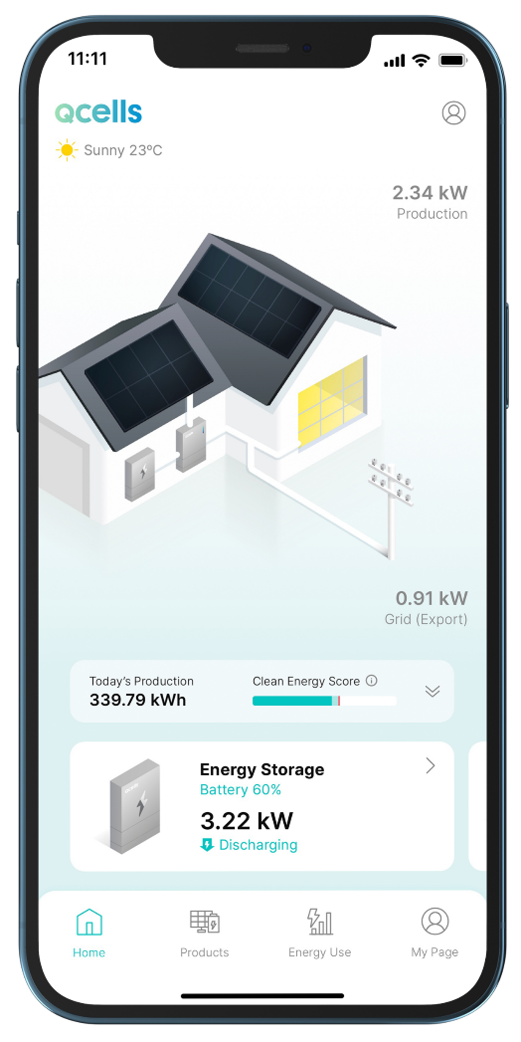
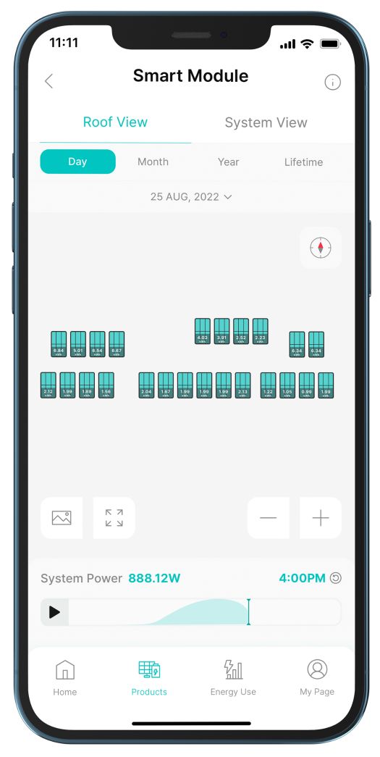
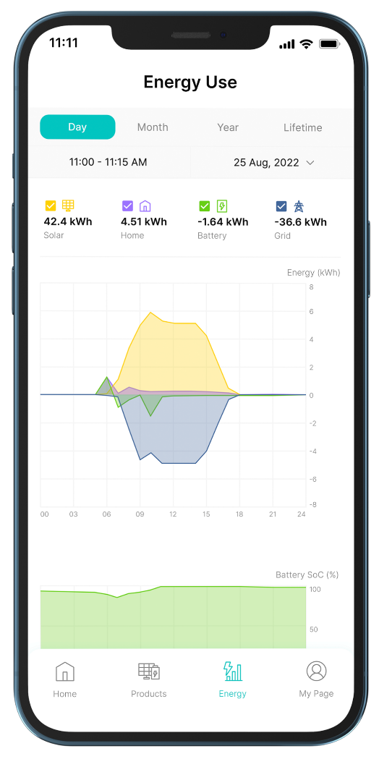
Energy Management System
Q.OMMAND HOME
For monitoring and managing energy generation, storage, and usage anytime, anywhere.
For Homeowners
Real-Time Energy Flow
Products
Regular Report
Smart Functions
Monitor the real-time energy flow,
Power with status, and energy
Production anytime and anywhere.
Provides easy access to the
Product information, real-time
Status and setting options for
Full energy control.
Analyze and compare your energy
Consumption easily over time.
The information is available
By hour, day, and year.
Q.OMMAND HOME provides
three smart functions as below.
1
Maximsed Energy Yield
Dynamic Optimizer
Qcells advanced AI algorithm incorporates
weather information with real-time data from
your solar modules and energy storage system
to maximize energy usage and generation.
2
Blackout Precaution
Energy Backup
In case of blackout, you can set the amount
of energy your Q.HOME CORE will always store.
3
Software Updates
OTA (Over-The-Air)
Cloud-based software updates continuously adds
new monitoring and management features.
32

Slide 11
Questions? ☺

